Slide 1
Naive Bayes Algorithm
جامعة البعث
الكلية التطبيقية
السنة الثالثة
قواعد معطيات 3
المحاضرة الرابعة (عملي)
إعداد المهندس بإشراف الدكتور
داني وسوف محمد حجوز

Slide 2
Introduction
A naïve Bayes classifier assumes that the presence of a particular feature in a class is unrelated to the presence of any other feature.
For example , a fruit may be considered to be an apple if it is red, round, and about 3 inches in diameter . All of these properties independently contribute to the probability that this fruite is an apple and that is why it is known as ‘Naive’.
Naïve Bayes model is easy to build and useful for very large data sets.

Slide 3
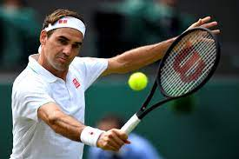
Weather Data: Play or not Play?
Outlook | Temperature | Humidity | Windy | Play?
sunny | hot | high | false | No
sunny | hot | high | true | No
overcast | hot | high | false | Yes
rain | mild | high | false | Yes
rain | cool | normal | false | Yes
rain | cool | normal | true | No
overcast | cool | normal | true | Yes
sunny | mild | high | false | No
sunny | cool | normal | false | Yes
rain | mild | normal | false | Yes
sunny | mild | normal | true | Yes
overcast | mild | high | true | Yes
overcast | hot | normal | false | Yes
rain | mild | high | true | No

Slide 4
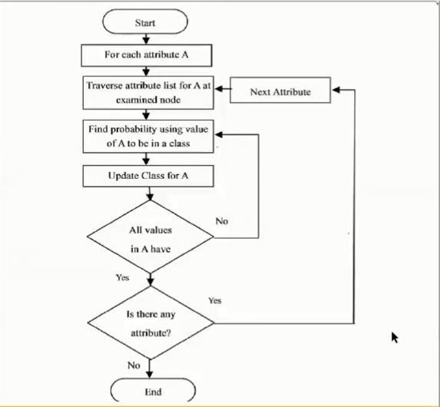
Flow Chart
.

Slide 5
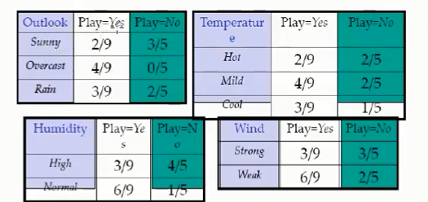

Calculate Probabilities

Slide 6
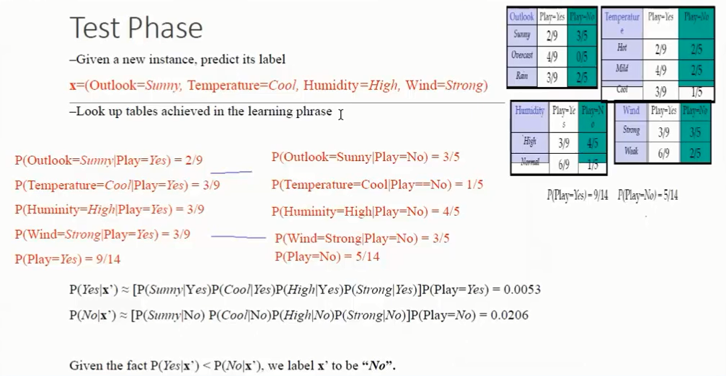

Slide 7
Advantages of Naïve Bayes
This algorithm work very fast and can easily test database.
You can use it to solve multi class problem (not just yes/no).

Slide 8
Disadvantages of Naïve Bayes
-The Naïve Bayes model will assign it zero probability and will not be able to make any predictions in this regard .
- It assumes that all the features are independent.

Slide 9
Thank you

